Slide 1
Interaction Effect in a Linear Regression Model
The interaction effect in a regression model occurs when the partial effect of a predictor variable on the response variable depends on the value of another predictor variable.

Slide 2
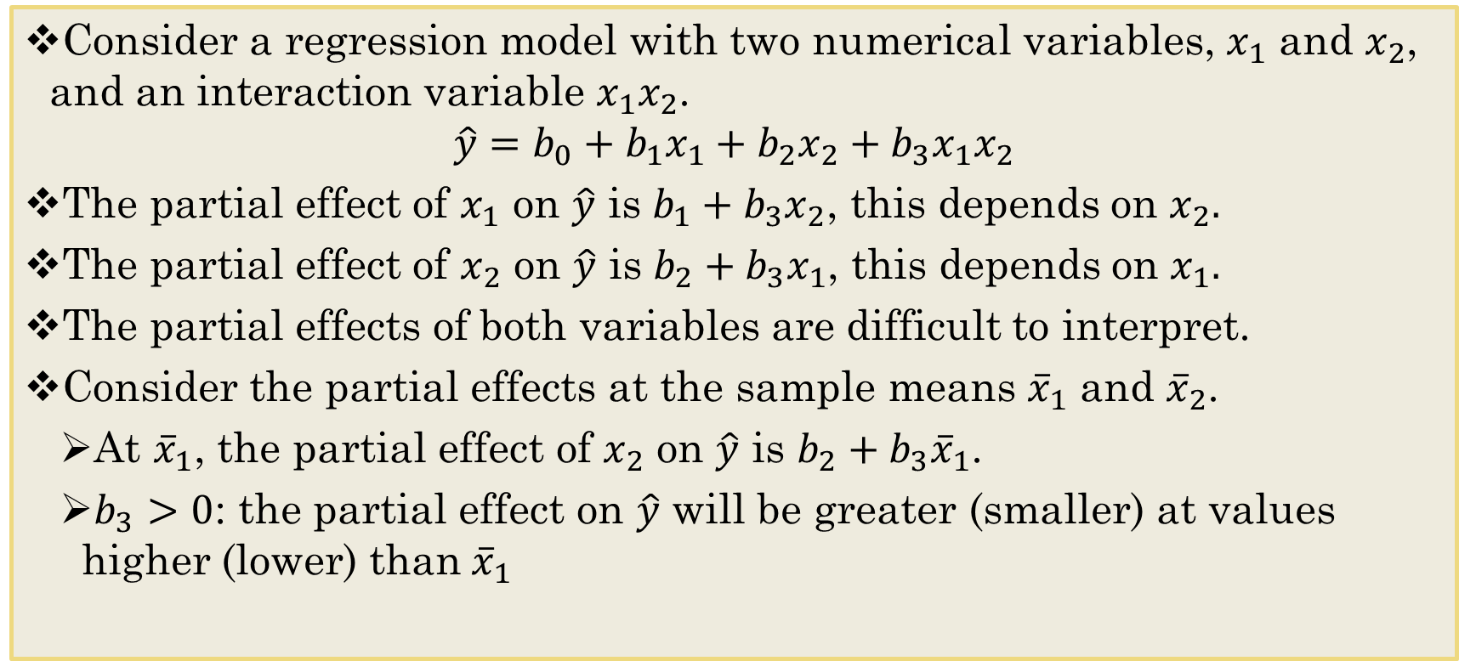
Regression Models with Interaction Variables
Consider a regression model with two numerical variables, $x_{1}$ and $x_{2}$, and an interaction variable $x_{1}x_{2}$.
$$\hat{y}=b_{0}+b_{1}x_{1}+b_{2}x_{2}+b_{3}x_{1}x_{2}$$
The partial effect of $x_{1}$ on $\hat{y}$ is $b_{1}+b_{3}x_{2}$, this depends on $x_{2}.$
The partial effect of $x_{2}$ on $\hat{y}$ is $b_{2}+b_{3}x_{1}$, this depends on $x_{1}.$
The partial effects of both variables are difficult to interpret.
Consider the partial effects at the sample means ${\overline{x}}_{1}$ and ${\overline{x}}_{2}$.
At ${\overline{x}}_{1}$, the partial effect of $x_{2}$ on $\hat{y}$ is $b_{2}+b_{3}{\overline{x}}_{1}$.
$b_{3}>0$: the partial effect on $\hat{y}$ will be greater (smaller) at values higher (lower) than${ \overline{x}}_{1}$
Notes:
Determine how the interaction between variables changes y
Partial effect: only one x depend on the other x, they don’t affect each other

Slide 3
Example
The interaction effect in a regression model occurs when the partial effect of a predictor variable on the response depends on the value of another predictor variable.
Example: An additional bedroom results in a higher increase in house prices for larger houses than smaller houses. Here, the effect of an additional bedroom depends on house size.
An interaction variable is the product of predictor variables.
Three types of interaction variables:
The interaction between two dummy variables
The interaction between a dummy variable and a numerical variable
The interaction between two numerical variables
A dummy variable is made from a categorical variable.

Slide 4
Interpreting Slopes of Interaction Terms
If the slope of an interaction term is positive it would mean that an increase in one variable will increase the effect of the other.
If the slope of an interaction term is negative, so the effect of one variable decreases the significance of the other.
Or that the effect of the combined action of two predictors is less then the sum of the individual effects.

Slide 5
To do
Work through next swirl: Regression_with_Interaction
Case Study Due Tonight
Note - Making Better use of my office hours!

